Slide 1
"Risks - Building an application scoring model for individuals".
Done by Lyu Yuri, Shirshov Konstantin, Golubkova Anna, Zhukhlistov Stanislav

Slide 2


Introduction
Notes:
With the development of personal loans and credit card business, credit scoring technology has been widely applied into lending decisions, asset pricing and post-loan management of the commercial banks. Credit scoring techniques is capable to help the commercial banks reduce the artificial one-sidedness when making the loan approval decisions, thus lowering the loss. Therefore, the personal credit scoring has played a very important role in the credit risk management of commercial banks.

Slide 3

The goal of the project
To ensure that clients capable of repayment are not rejected and that loans are given with a principal, maturity, and repayment calendar that will empower their clients to be successful.
Notes:
Personal credit scoring has played an extremely important role in the credit risk management of commercial banks. Specially, application scoring provides an important basis for the approval of customers’ credit application for the first time.
Many people struggle to get loans due to insufficient or non-existent credit histories. And, unfortunately, this population is often taken advantage of by untrustworthy lenders. So, we can say that our final goal is to ensure that clients capable of repayment are not rejected and that loans are given with a principal, maturity, and repayment calendar that will empower their clients to be successful.

Slide 4
Explanatory Data Analysis
The training data has 307511 observations (each one a separate loan) and 122 features (variables) including the TARGET (the label we want to predict).
The test dataset is considerably smaller(48744 observations) and lacks a TARGET column.
Main Steps:
Correlation Matrix
Number of unique, null and empty values
Mean, median, standard deviation, minimum and maximum of parameters
Distributions

Slide 5
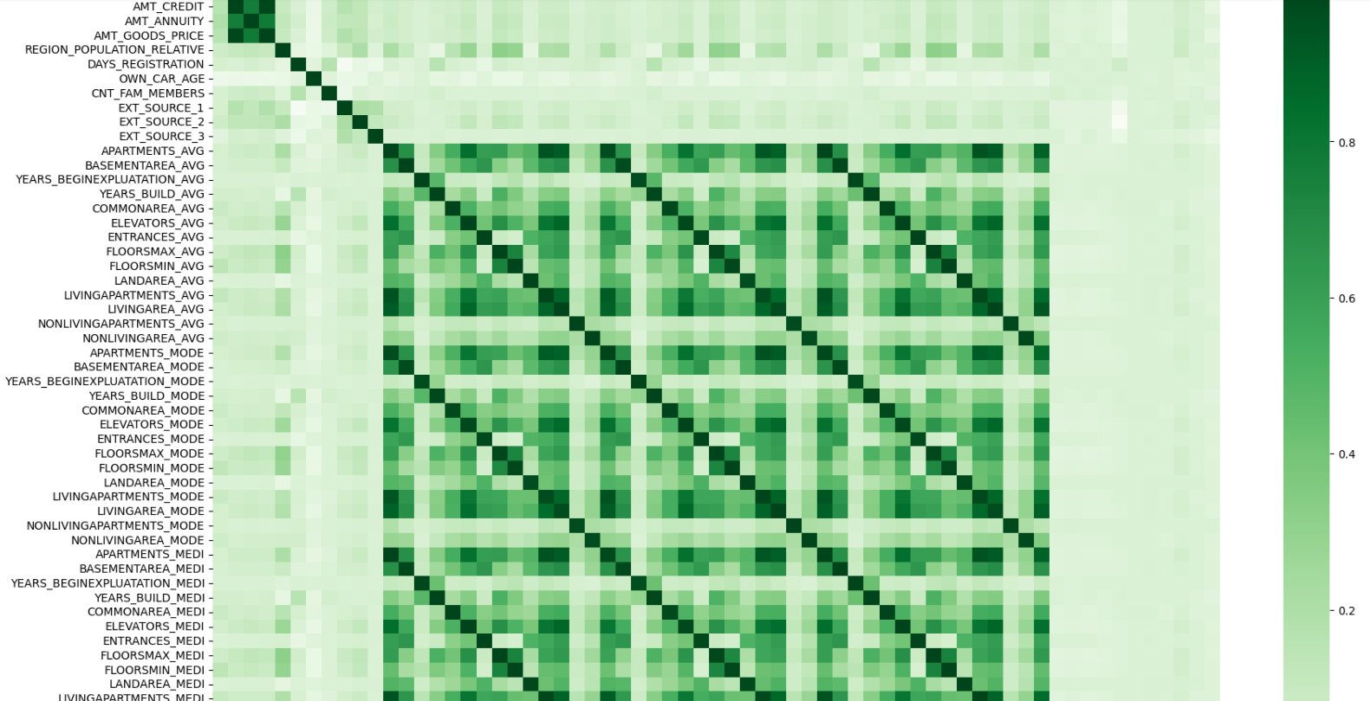
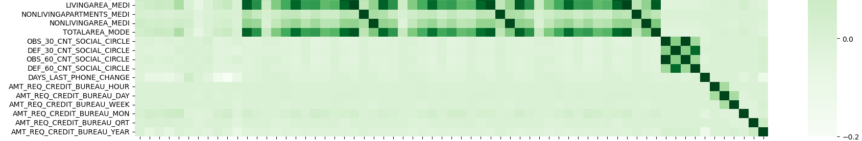
Explanatory Data Analysis - Correlation matrix

Slide 6
Explanatory Data Analysis
Correlation Matrix
1) The combination of AMT_CREDIT, AMT_ANNUITY and AMT_GOODS_PRICE. The correlation here is pretty high.
2) The combination of variables starting from APARTMENTS_AVG and finishing by TOTALAREA_MODE. The correlation here is outstanding and at the same time chaotically specific for certain variables.
3) The combination of OBS_30_CNT_SOCIAL_CIRCLE, DEF_30_CNT_SOCIAL_CIRCLE,OBS_60_CNT_SOCIAL_CIRCLE and DEF_60_CNT_SOCIAL_CIRCLE. The correlation here is quite high.

Slide 7
Explanatory Data Analysis
Number of unique, null and empty values
The maximum proportion of NAs exceeds 69.9%
TARGET variable is 91.8% null, because it takes values of either 1 or 0.
37 variables from our training data have no null values at all, and the rest varies on average from 17% to 90%.
The variable CODE_GENDER contains three unique values and we found out later that there is one extra one called XNA.

Slide 8
Explanatory Data Analysis
Mean, median, standard deviation, minimum and maximum of parameters
There are negative values that are acceptable for analysis, namely:
DAYS_BIRTH
DAYS_EMPLOYED
DAYS_REGISTRATION
DAYS_ID_PUBLISH
DAYS_LAST_PHONE_CHANGE

Slide 9
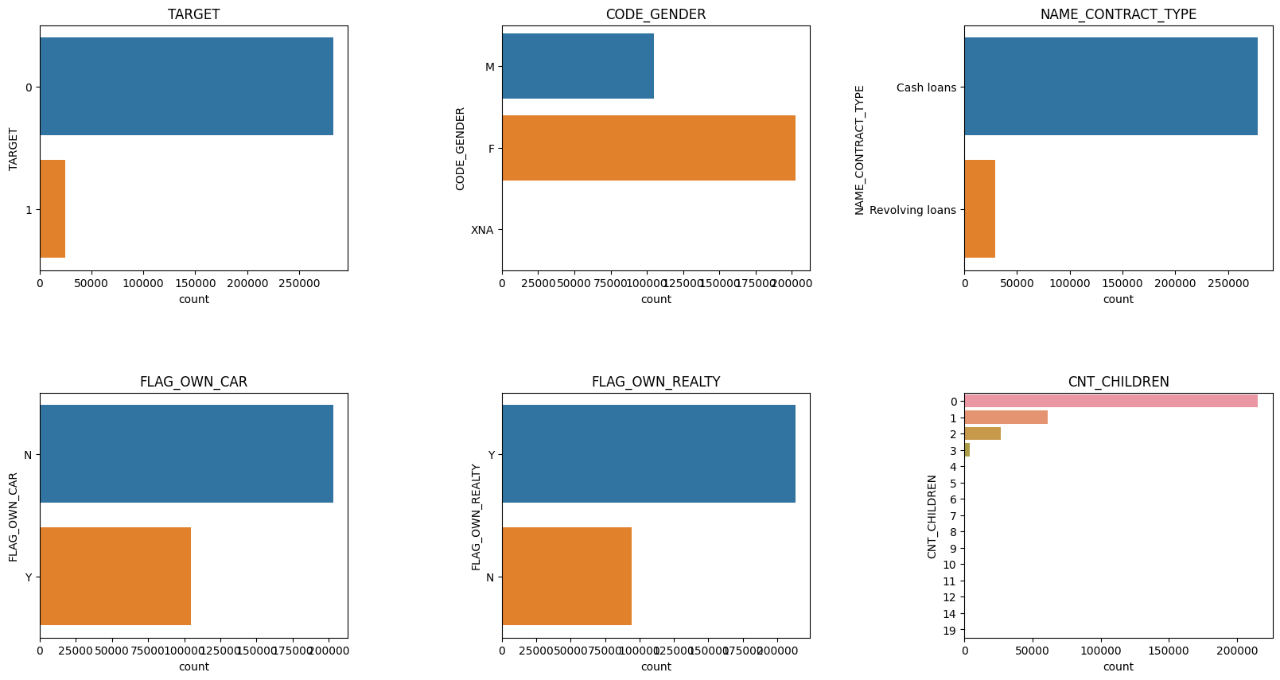
Explanatory Data Analysis
Distributions

Slide 10
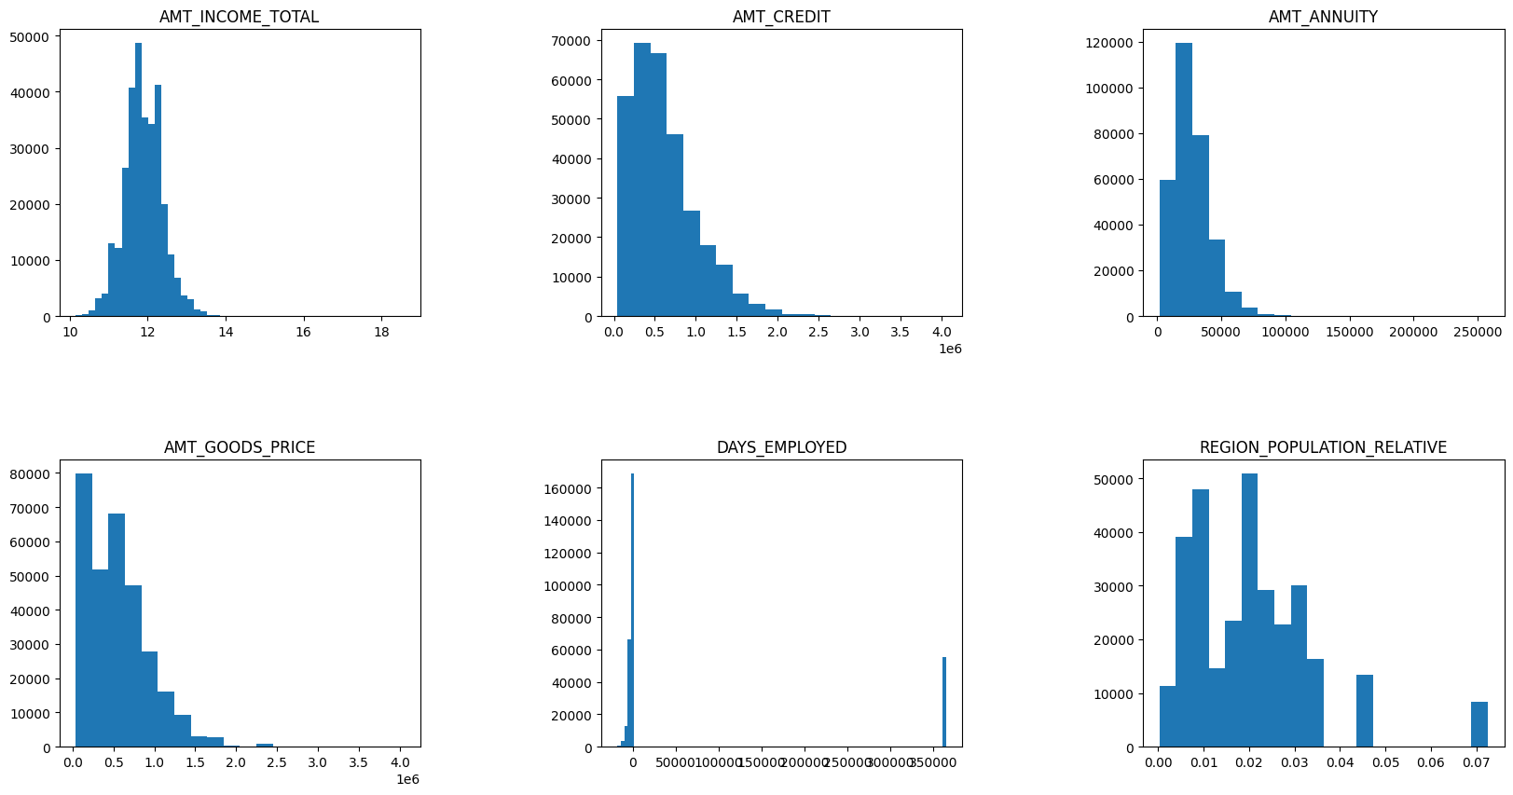
Explanatory Data Analysis
Distributions

Slide 11
Data engineering - null values
Delete most of the NaNs by dropping NaNs in the column with the most NaNs
Drop columns with high NaNs
Fill the rest with median/mean values

Slide 12
New variables
credit_to_income_ratio = AMT_CREDIT / AMT_INCOME_TOTAL
days_employed_percentage = DAYS_EMPLOYED / DAYS_BIRTH
income_per_person = AMT_INCOME_TOTAL / CNT_FAM_MEMBERS
non_child_count = CNT_FAM_MEMBERS - CNT_CHILDREN

Slide 13
Implemented standard practices
Replace “Unknown” and “XNA” with NaN
One-Hot Encoding
Min-Max normalization
Drop ID

Slide 14
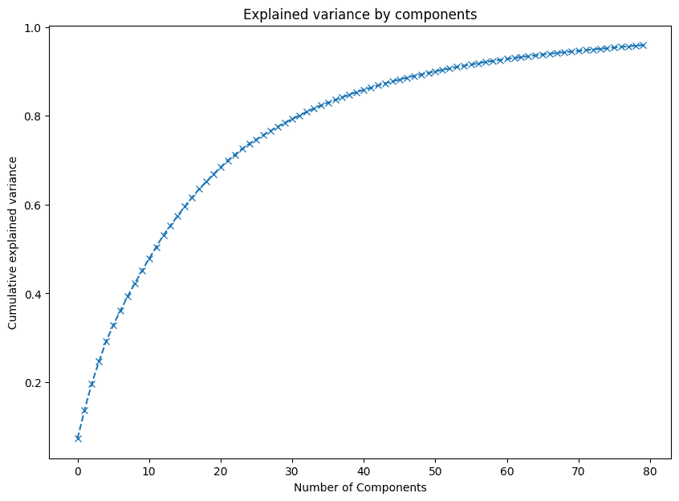
PCA

Slide 15

Imbalanced dataset problem

Slide 16
Imbalanced dataset problem
Method | Score
Take equal number of observations randomly from train dataset per value of target variable | 0.6527077497665733
Bootstrapping | 0.6547152194211018
Upsampling | 0.657469654528478
Near-Miss algorithms | 0.5510270774976658

Slide 17
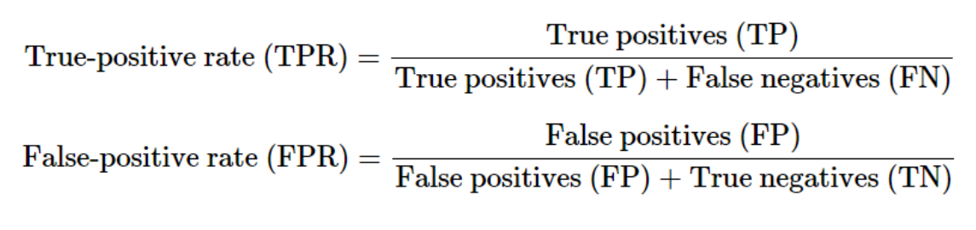
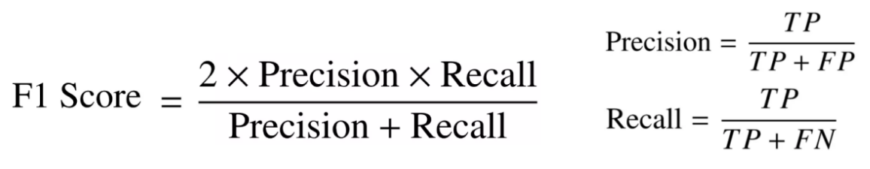
Selection of appropriate metrics
ROC-AUC:
Notes:
Before selecting models and fitting them, it is important to choose the appropriate metrics that will be used to evaluate performance of the models and compare them. We have a task of binary classification.
One of stable and powerful metrics to evaluate the performance of a binary classification model is ROC-AUC score. For explaining this metric we need additional notations:
True Positives(TP) is the number of observations correctly predicted as “0” (will repay loan on time)
False Positives(FP) is the number of observations wrongly predicted as “1” (will have difficulty repaying loan)
True Negatives(TN) is the number of observations correctly predicted as “1” (will have difficulty repaying loan)
False Negatives(FN) is the number of observations wrongly predicted as “0” (will repay loan on time)
ROC(Receiver Operator Characteristic) curve is a graph that summarizes the performance of a classifier over all possible probability thresholds. ROC curve is generated by plotting a model’s false-positive rate against its true-positive rate across a range of classification thresholds. The ROC- AUC score is basically the area under the ROC curve. The ROC-AUC score varies from 0 to 1: the closer the score is to 1, the better model is considered. ROC curve can be biased for imbalanced datasets. Thus, we may need additional metric that will help to differentiate how good the models’ performances are.
Here we can use F1 metric that assesses the predictive skill of a model by elaborating on its performance by class rather than an overall performance. For explaining this metric we need additional notations:
F1 score combines the precision and recall metrics into a single metric. Generally, the F1 score work well on imbalanced datasets. The F1 score varies from 0 to 1: a higher F1 score denotes a better classification model.
ROC-AUC metric will be used to estimate the quality of predictions. Also, f1 score will be used as an additional metric. But the main metric will be ROC-AUC since our dataset is well-balanced and we want to classify both classes well.

Slide 18
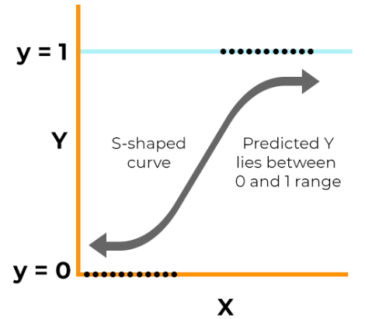
Logistic Regression
Logistic regression is a supervised machine learning algorithm mainly used for classification tasks where the goal is to predict the probability that an instance belongs to a given class. It is referred to as a regression because it takes the output of the linear regression function as input and uses a sigmoid function to estimate the probability for the given class.

Slide 19
Logistic Regression
After selecting hyperparameters using grid search, we received the following estimates for the ROC-AUC and F1 metrics.

Slide 20
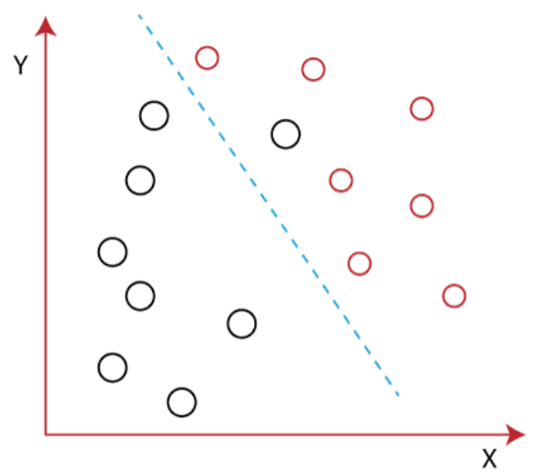
LDA
Linear Discriminant Analysis, or LDA, is a supervised machine learning algorithm used for classification tasks in machine learning. It is a technique used to find a linear combination of features that best separates the classes in a dataset.

Slide 21
LDA
After selecting hyperparameters using grid search, we received the following estimates for the ROC-AUC and F1 metrics.

Slide 22
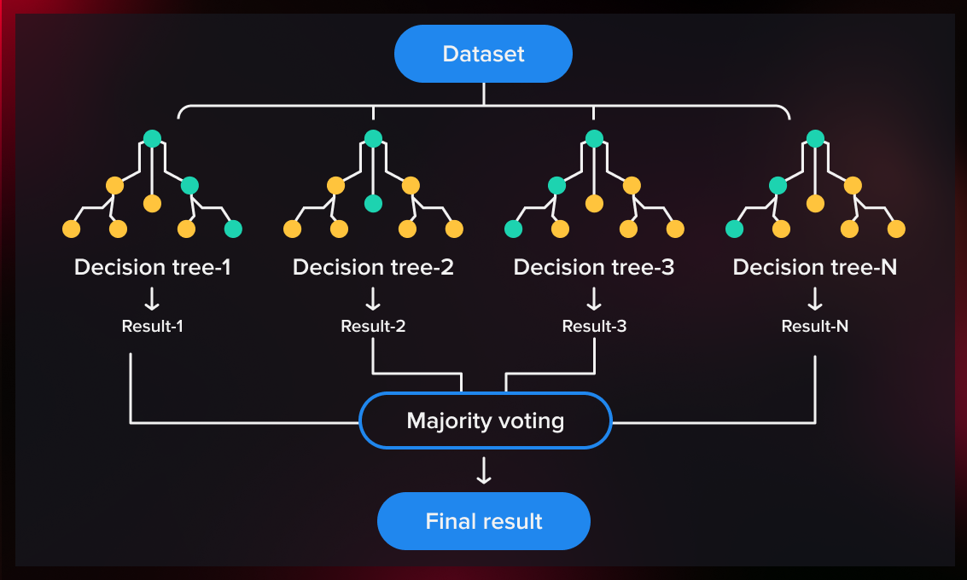
Random Forest
A random forest is a supervised machine learning algorithm in which the calculations of numerous decision trees are combined to produce one final result.
Notes:
Predicting customer behavior, consumer demand or stock price fluctuations, identifying fraud, and diagnosing patients – these are some of the popular applications of the random forest algorithm. Used for classification and regression tasks, it can significantly enhance the efficiency of business processes and scientific research.

Slide 23
Random Forest
After selecting hyperparameters using grid search, we received the following estimates for the ROC-AUC and F1 metrics.
Notes:
So that we know on which feature to split first and how, the relevance and importance of each feature must be determined.
This is done by using grid search method. In broad terms, it usually searches exhaustively through a manually specified subset of the hyperparameter space of the targeted algorithm.

Slide 24
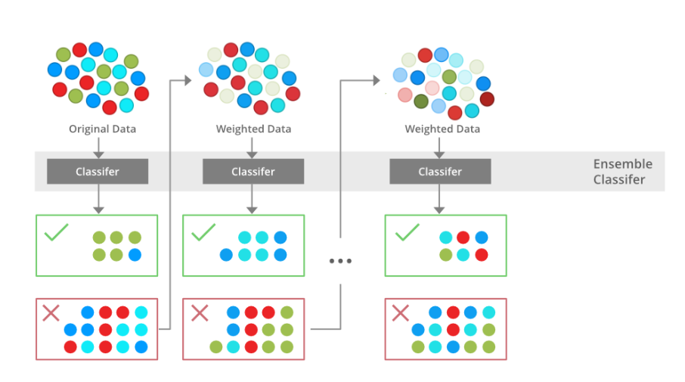
XGBoost Classifier
XGBoost (eXtreme Gradient Boosting) is a popular supervised-learning algorithm used for regression and classification on large datasets. In this algorithm, decision trees are created in sequential form with weights. These individual classifiers then ensemble to give a strong and more precise model.

Slide 25
XGBoost Classifier
After selecting hyperparameters using grid search, we received the following estimates for the ROC-AUC and F1 metrics.

Slide 26
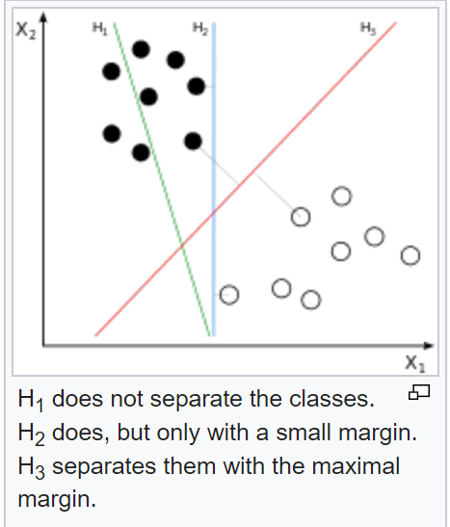
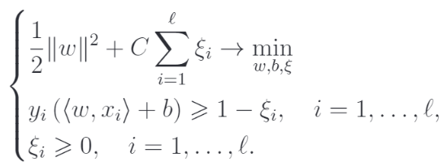
Support Vector Machine Classifier

Slide 27
Support Vector Machine Classifier
dual=False
Tune C and tol using logarithmic grid base 10.
C - Regularization parameter. The strength of the regularization is inversely proportional to C.
tol - Tolerance for stopping criteria.
Result: best C = 1e-1, best tol = 1e-3

Slide 28
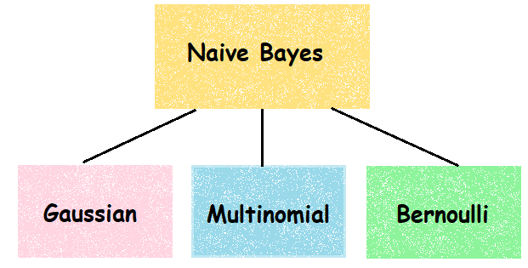
Naive Bayes
Bernoulli Naive Bayes is a classification algorithm based on Bayes' Theorem. It is used for binary and multi-class classification problems where the features are represented using binary values (0 or 1). In this algorithm, the probability of a class is computed by multiplying the probabilities of each feature being present in that class.
Notes:
Predicting customer behavior, consumer demand or stock price fluctuations, identifying fraud, and diagnosing patients – these are some of the popular applications of the random forest algorithm. Used for classification and regression tasks, it can significantly enhance the efficiency of business processes and scientific research.

Slide 29
Naive Bayes
After selecting hyperparameters using grid search, we received the following estimates for the ROC-AUC and F1 metrics.
Notes:
Predicting customer behavior, consumer demand or stock price fluctuations, identifying fraud, and diagnosing patients – these are some of the popular applications of the random forest algorithm. Used for classification and regression tasks, it can significantly enhance the efficiency of business processes and scientific research.

Slide 30
Comparison of models after the selection of hyperparameters
 | Logistic Regression | Linear Discriminant Analysis | RandomForestClassifier | XGBClassifier | LinearSVC | BernoulliNB
ROC-AUC Train | 0.6631 | 0.6629 | 0.6842 | 0.7431 | 0.6638 | 0.6428
ROC-AUC Test | 0.6595 | 0.6609 | 0.6331 | 0.6428 | 0.6601 | 0.6188
F1 Train | 0.6649 | 0.6652 | 0.6822 | 0.7469 | 0.6661 | 0.6413
F1 Test | 0.2226 | 0.2231 | 0.2103 | 0.2222 | 0.2227 | 0.1958
The best model: Linear Discriminant Analysis

Slide 31
Practical usage and Conclusion
After fitting the models and hyperparameter tuning, we conclude that LDA is the best model based on validation on the test dataset. However, Logistic Regression and Support Vector Machine Classifier also performed well.
Even though LDA showed the best performance, it was decided to choose Logistic Regression as our final model due minor difference between models and its simplicity(relatively easy to operate and maintain).
We propose the following usage of the model for the real world tasks: the model makes a decision to give a loan depending on the information received by employees of the bank from a client.
Maintenance of the model will be done with constant data updates and further improvement of the model to meet the needs of the bank or obtain a model with a higher level of accuracy.

